Slide 1
MDO – Marketing Digital Outdoor
Design
Embedded Systems
Group 8:
José Pires | A50178
Hugo Freitas | A88258

Slide 2
Agenda
Recap
Problem statement
Analysis – System Overview
Theoretical Foundations
Design
Hardware Specification
Hardware Interfaces Definition
Software Specification
Software Interfaces Definition

Slide 3
1. Introduction

Slide 4
Problem Statement
The project consists of a marketing digital outdoor (MDO) with:
sound and video display, and fragrance emission selected by the brands,
providing a gesture-based interface for user interaction to create pictures and GIFs, brand-specific,
and share them on social media.

Slide 5
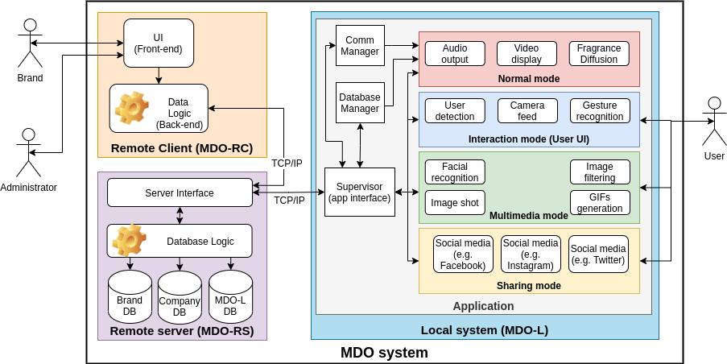
Analysis System Overview

Slide 6
Analysis System Overview
Hardware Architecture

Slide 7
Analysis System Overview
Software Architecture
Remote Client

Slide 8
Analysis System Overview
Software Architecture
Remote Server

Slide 9
Analysis System Overview
Software Architecture – Local System

Slide 10
2. Theoretical Foundations

Slide 11
Theoretical Foundations Scenting Technologies
These are all the topics that are aborded in this project:
Project Methodology;
Concurrency;
Threads versus processes;
Communications;
Daemons;
Device Drivers;
Build systems and Makefiles;
Source code documentation;
Scenting Technologies;
Computer Vision;
RDBMS;
Motion Detection;
Camera Recording and codecs;
Image filtering;
GIF Generation;
C/C++ Libraries and APIs;
Social Media APIs
UI Framework
File transfer Protocols

Slide 12
Theoretical Foundations Scenting Technologies
A scenting technology transforms an aromatic liquid into a gaseous fluid that can be conveyed through the air and be captured by human olfactory sense, usually for therapeutic or marketing purposes.
Ultrasonic Diffusion:
Ultrasonic diffusion uses high frequency stimuli to brake down water molecules into droplets, producing mist, diffusing the oils into the air. The high frequency stimuli is above 20 kHz, the upper threshold for audible human hearing — thus the ultrasonic naming — and it’s accomplished using micro-mesh piezoelectric transducers.

Slide 13
Theoretical Foundations Scenting Technologies

Slide 14
Theoretical Foundations Scenting Technologies

Slide 15
Theoretical Foundations Computer Vision
Computer vision is a vast field, but can broadly be defined as the transformation of data from a still image or video camera into either a decision or a new representation to achieve some particular goal [36].
Computer vision framework
OpenCV: it is an open-source computer vision and machine learning software library, built to provide a common infrastructure for computer vision applications and accelerate the use of machine perception in commercial products.
Face detection
Recent studies [47, 48] show that face detection can be further improved by using deep learning, leveraging the high capacity of deep convolutional networks.

Slide 16
Theoretical Foundations Computer Vision
Haar Cascade classifier

Slide 17
Theoretical Foundations Computer Vision
Haar Cascade classifier

Slide 18
Theoretical Foundations Computer Vision
Hand Gesture Recognition

Slide 19
Theoretical Foundations Computer Vision
Hand Gesture Recognition

Slide 20
Theoretical Foundations RDBMS
Levels of abstraction

Slide 21
Theoretical Foundations RDBMS
Structure of a RDBMS

Slide 22
Theoretical Foundations RDBMS
Example of na ERD

Slide 23
Theoretical Foundations RDBMS
SQL

Slide 24
Theoretical Foundations RDBMS
SQL

Slide 25
Theoretical Foundations RDBMS
SQL

Slide 26
Theoretical Foundations Motion Detection
The MDO-L needs to be capable of detecting a user, in order to switch between normal mode to interaction mode.
Ultrasonic Sensor
The sensor determines the distance to a target by measuring time lapses between the sending and receiving of the ultrasonic pulse [69].

Slide 27
Theoretical Foundations Camera recording and codecs
Video encoding formats, also called video file formats, are methods of optimizing digital video files for different platforms, programs, and devices.
Processes of video encoding:
Compression: decreases the size of a video file so that it is more manageable. Without proper compression, most files would be far too large to upload easily, load quickly, or play smoothly on users’ devices.
Transcoding: refers to the total audio and video conversion process from one video format to another. It ensures that a video file is compatible with the video player and/or platform it is using. Without transcoding, users would not be able to watch the video file at all.

Slide 28
Theoretical Foundations Image Filtering
After detect the face, it is now possible to apply filters like this figure.
Scaling the image having in touch the face size and put the image in front of the face.

Slide 29
Theoretical Foundations GIF Generation
The main features of GIF are:
Up to 256 colors using 1 to 8 bits per pixel: allowing a single image to reference its own palette chosen from the 24-bit color space. These palette limitations make GIF less suitable for reproducing color photographs, but well-suited for simpler images such as graphics or logos with solid areas of color.
Multiple images per file: supporting animation.
GIF images are compressed using the Lempel–Ziv–Welch (LZW) lossless data compression technique to reduce the file size without degrading the visual quality. It stores multi-byte integers with the Least Significant Bit (LSB) first (little–endian) [76].

Slide 30
Theoretical Foundations Social Media Sharing APIs
These platforms provide a set of functionalities to external agents interact with them in a programmatic way, enabling automation of tasks like content sharing, scheduling, search, etc. These functionalities are exposed by APIs, providing a custom and well-defined interface that can be explored by developers to build custom applications that leverages on them.
Twitter API: To interact with the Twitter platform, one can make a request and retrieve its response by following these steps [87]:
Select the end-point;
Select a tool to make the request;
Review the response;
Adjust the request using parameters.

Slide 31
Theoretical Foundations UI Framework
QT was the chosen one for the following reasons:
Allows cross development;
Cost: this framework is cost-friendly, not only because it has a free license, but also because its software development takes less time to develop due to the integrated environment assisting the developer.
Implementation: it is implemented in C++, which means that it is possible to use many libraries. The wide choice of modules allow the project to have rich functionality and as a result, the software will have a Graphical User Interface (GUI) similar to a native one.

Slide 32
Theoretical Foundations File Transfer Protocols
HTTPS:
The communications between subsystems are made through TCP/IP, this is also used in this protocol which is an advantage;
The data is transferred only with authentications (request and responses) which makes it more secure;
All communication is encrypted, which makes it even more secure.
Third Party API:
Transfer.sh: This application has easy-to-use commands in order to transfer files with a URL, there is unlimited upload, it can encrypt files and it is also possible to limit the amount of downloads and days available of downloading [104].
Using the library curlpp with the transfer.sh API, it is possible to create a program to transfer files between nodes automatically when requested from the user

Slide 33
3. Design

Slide 34
3.1. Hardware

Slide 35
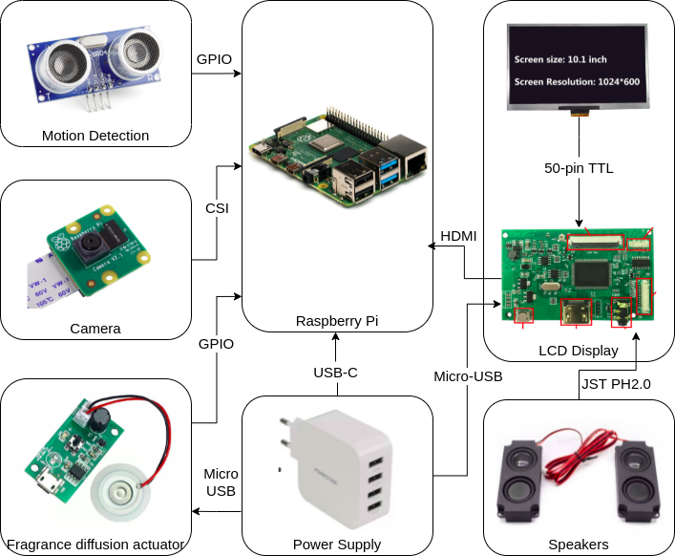
Design Hardware Architecture

Slide 36
Design Hardware Architecture
Main Controller:
Processor: Broadcom BCM2711 processor, quad-core Cortex-A72 (ARM v8) 64-bit with 1.5GHz;
Memory: 4GB LPDDR4 with on-die ECC;
Connectivity: 2.4 GHz and 5.0 GHz IEEE 802.11b/g/n/ac wireless LAN, Bluetooth 5.0 with low energy, one Gigabit Ethernet port, four USB ports in which two are 3.0 and another two are 2.0;
GPIO: standard 40-pin GPIO fully backwards-compatible with previous boards;
Video and Sound: two HDMI ports that support up to 4kp60, a 2-lane MIPI DSI display port, a 2-lane MIPI CSI camera port and a 4-pole stereo audio and composite video port;
Multimedia: H.265 (4Kp60 decode), H.264(1080p60 decode and 1080p30 encode) and OpenGL ES 3.0 graphics;
SD card support: Micro SD card slot for loading operating system and data storage;
Input power: 5V Direct Current (DC) via USB-C connector (minimum 3A), 5V DC via GPIO header (minimum 3A) and Power over Ethernet (PoE) - enabled (requires separate PoE HAT);
Environment: it has a range of operation between 0ºC and 50ºC.

Slide 37
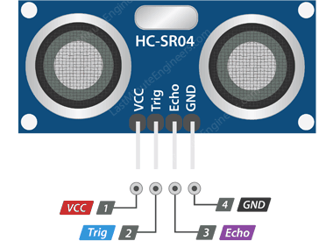
Design Hardware Architecture
Motion Detection(HC-SR04):
Operating Voltage: 5V DC;
Operating Current: 15 milliampere (mA);
Operating Frequency: 40 KHz;
Maximum Range: 4 meters;
Minimum Range: 2 centimeters;
Ranging Accuracy: 3 millimeters;
Measuring Angle: 15 degrees;
Trigger Input Signal: 10 microseconds TTL pulse;
Dimension: 45 x 20 x 15 millimeters.

Slide 38
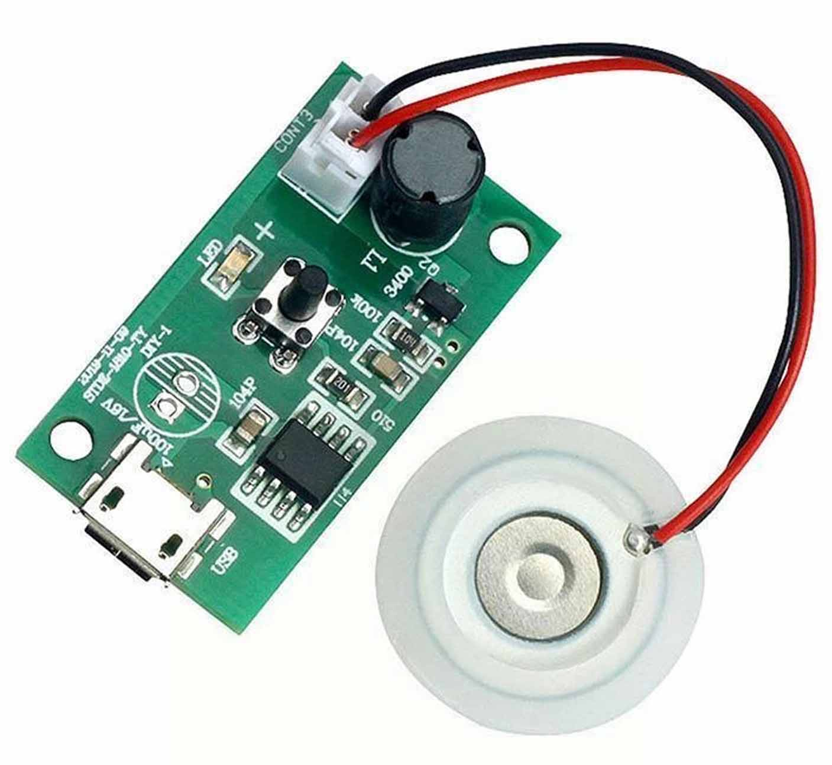
Design Hardware Architecture
Fragrance diffusion actuator:
Operating Voltage: 5V DC;
Operating Current: 300 milliampere (mA);
Operating Power: 2 W;
Operating Frequency: 108 kHz;
Dimension: 35 x 20 x 17 millimeters.

Slide 39
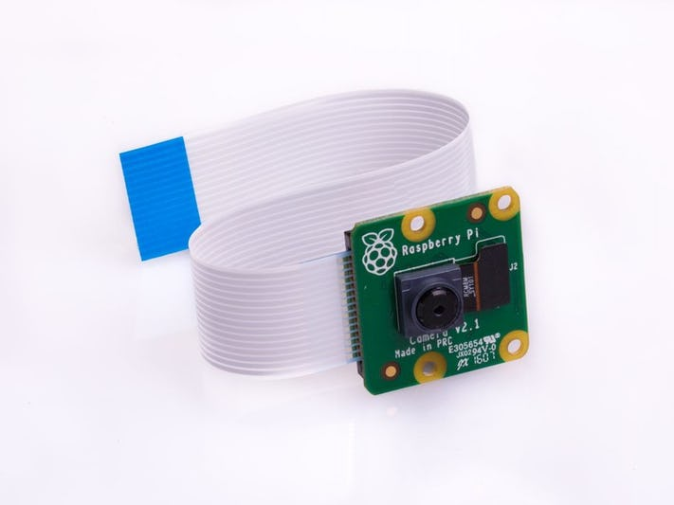
Design Hardware Architecture
Camera (Raspberry Pi Camera Module V2):
Sensor: Sony IMX219 8-megapixel;
Quality: 1080p30, 720p60;
Interface: CSI;

Slide 40
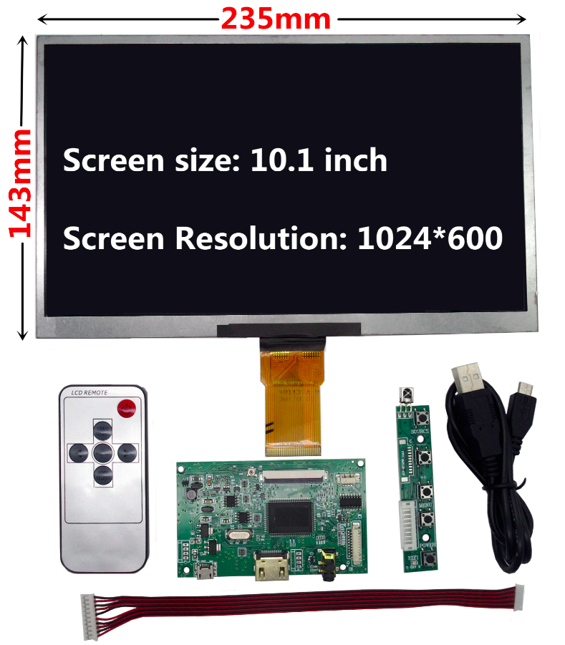
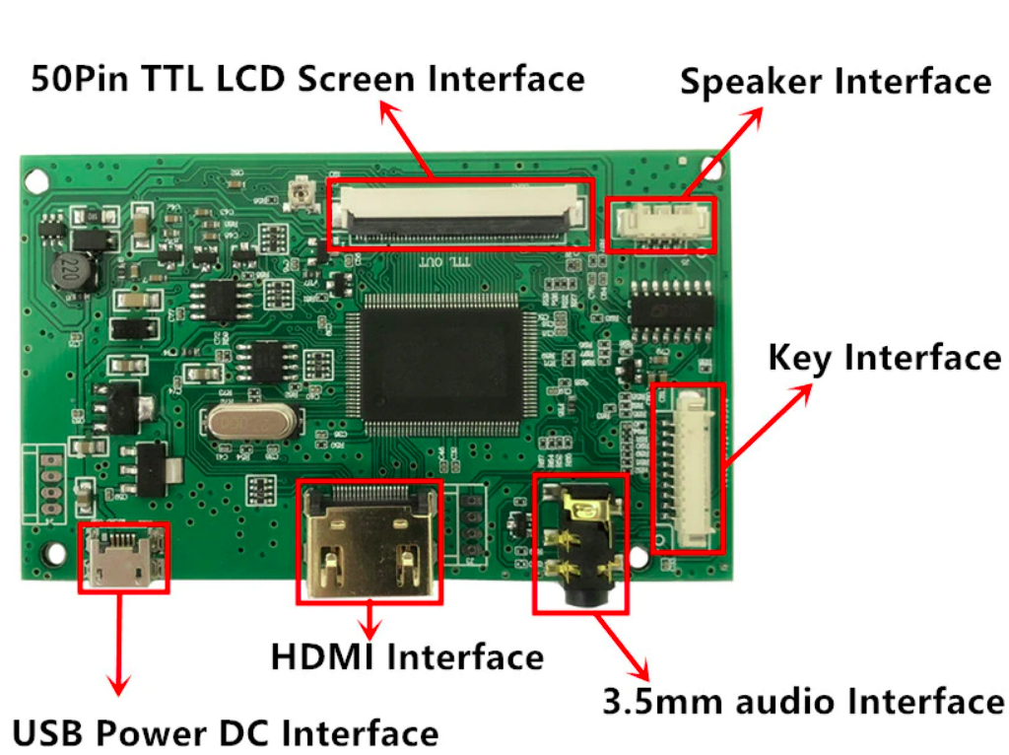
Design Hardware Architecture
LCD Display:

Slide 41
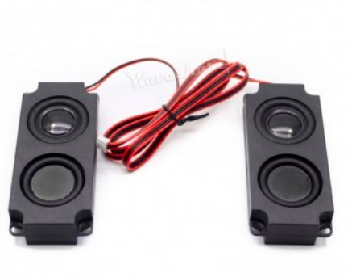
Design Hardware Architecture
Speakers (Raspberry Pi Camera Module V2):
Impedance: 8 Ohm;
Power: 5 W;
Interface: JST PH2.0.

Slide 42
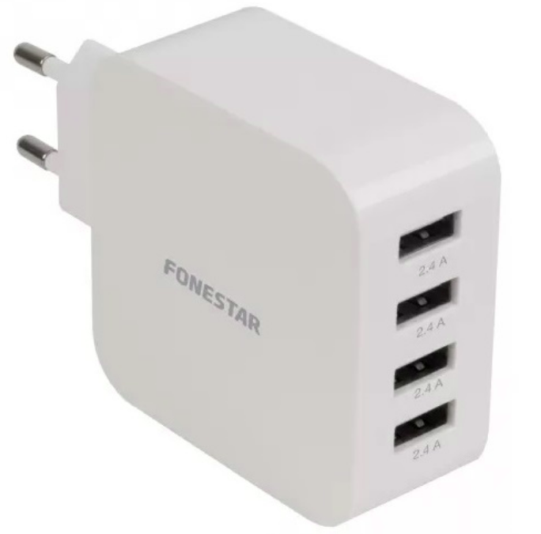
Design Hardware Architecture
Power Supply:
Output: 4 USB-A 2.4 A ports.

Slide 43
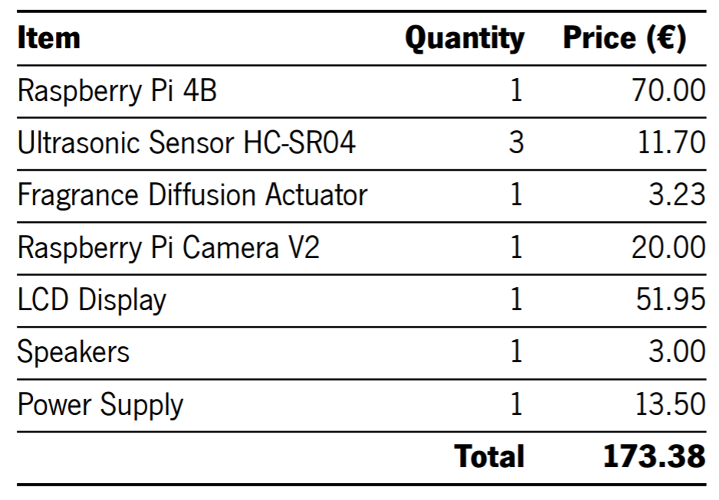
Design Hardware Architecture
Total cost:

Slide 44
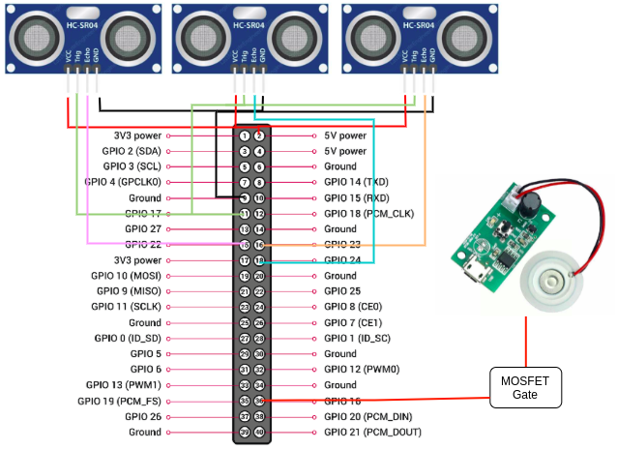
Design Hardware Interfaces Definition

Slide 45
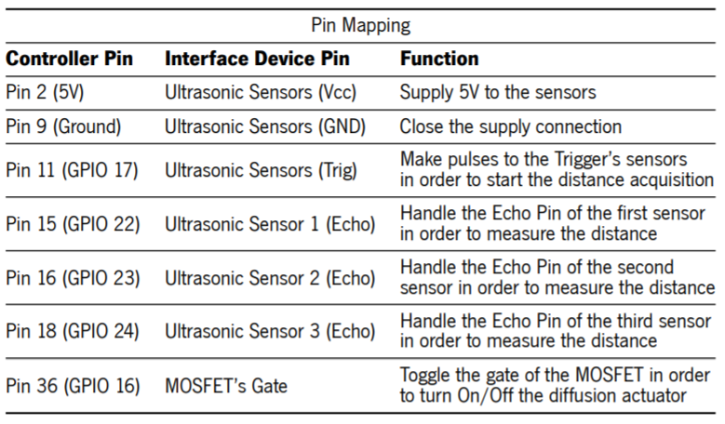
Design Hardware Interfaces Definition

Slide 46
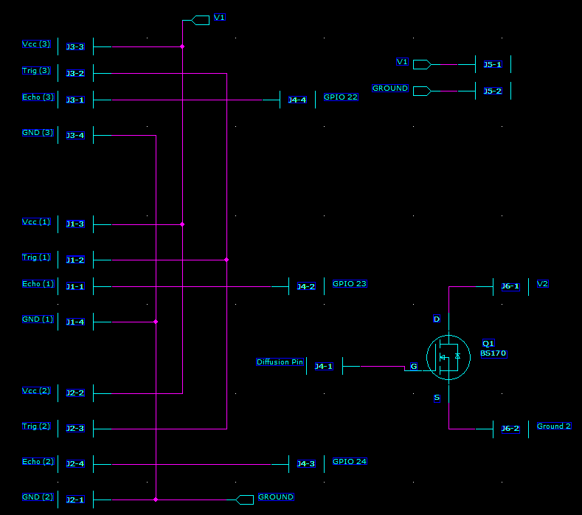
Design PCB Design
Schematic

Slide 47
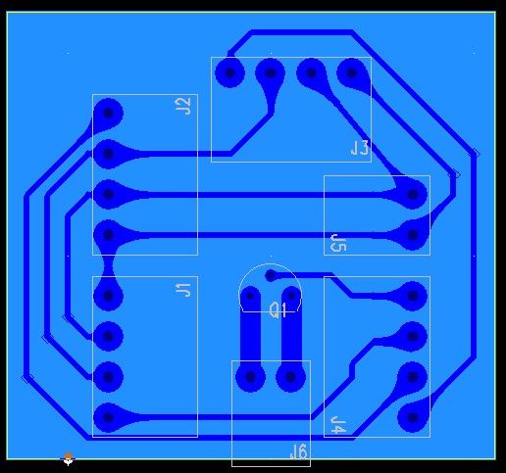
Design PCB Design
Layout

Slide 48
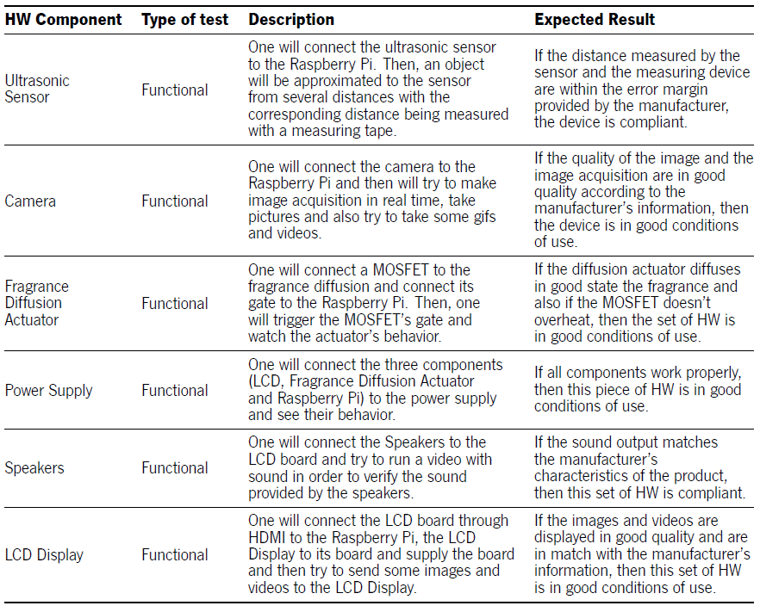
Design Hardware Test Cases

Slide 49
3.2. Software

Slide 50
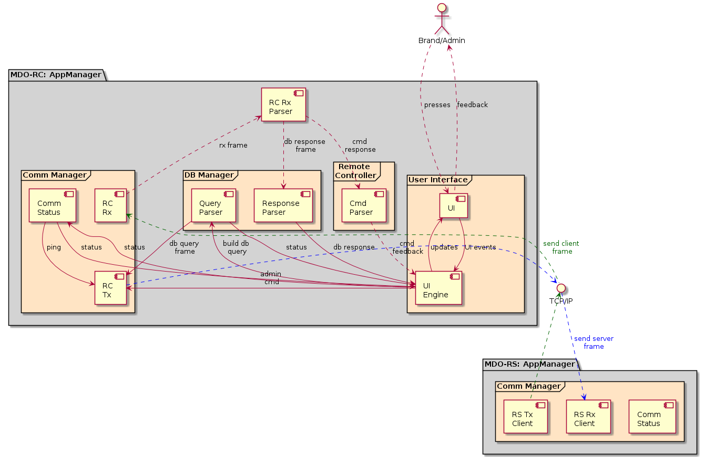
Design Component Diagram
Remote Client

Slide 51
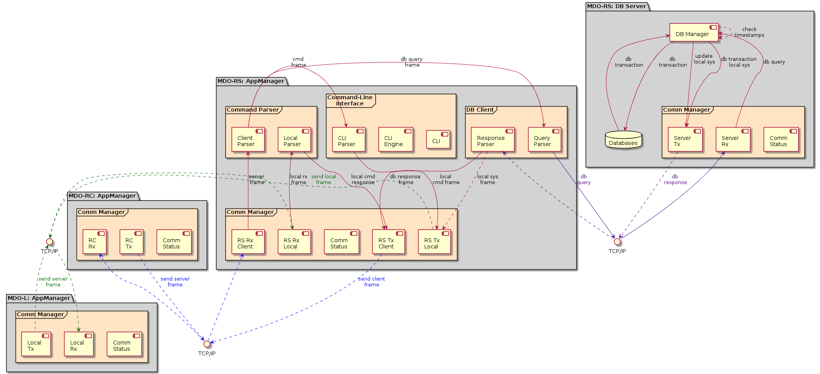
Design Component Diagram
Remote Server

Slide 52
Design Component Diagram
Remote Server

Slide 53
Design Component Diagram
Remote Server

Slide 54
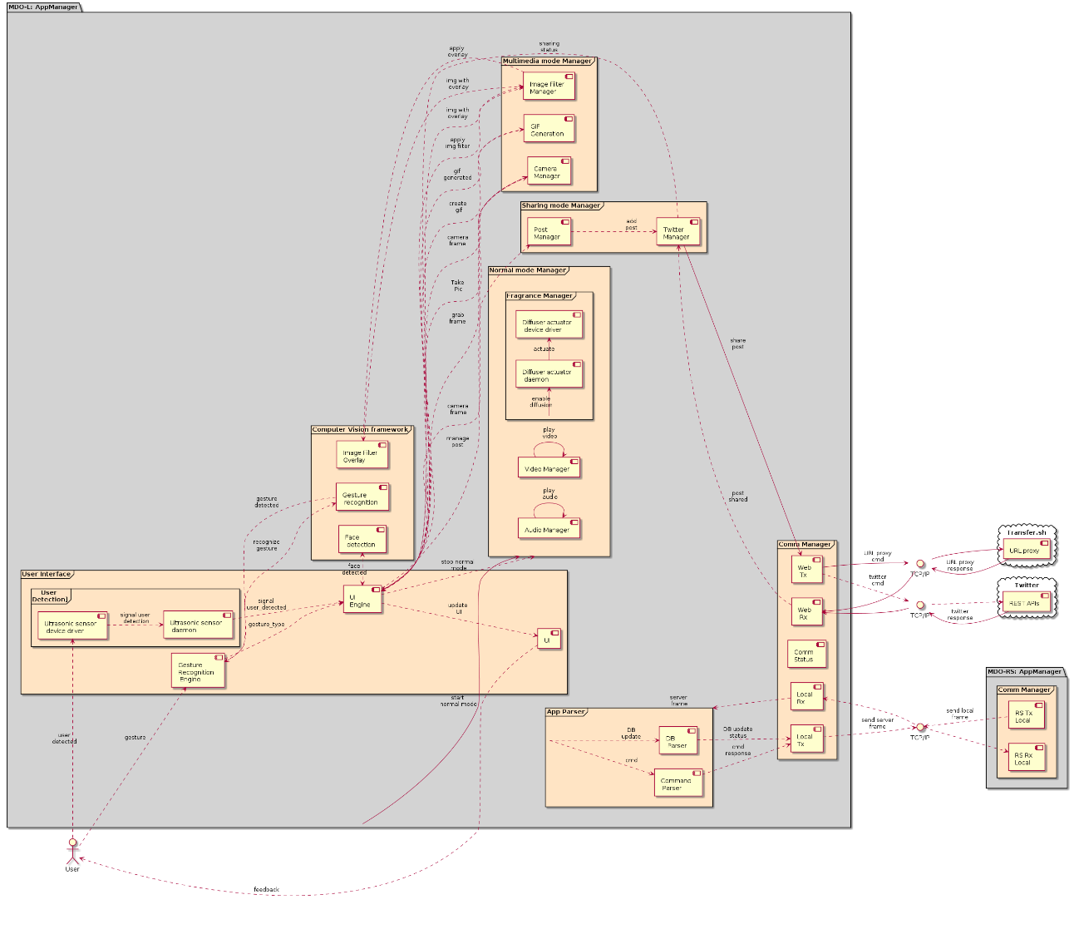
Design Component Diagram
Local System

Slide 55

Design Component Diagram
Local System

Slide 56
Design Component Diagram
Local System

Slide 57
Design Component Diagram
Local System

Slide 58
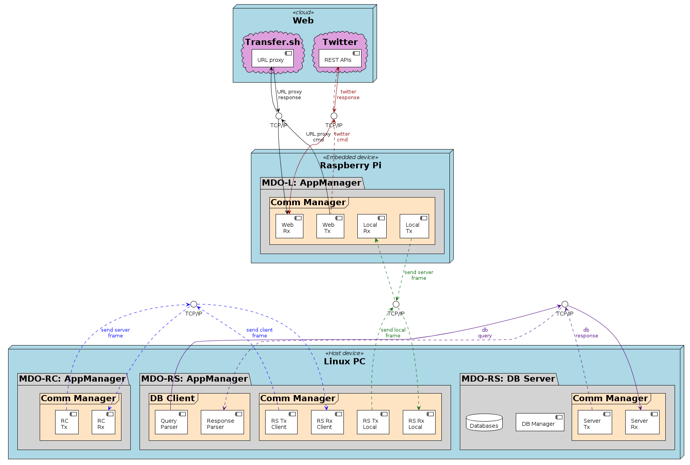
Design Deployment Diagram

Slide 59
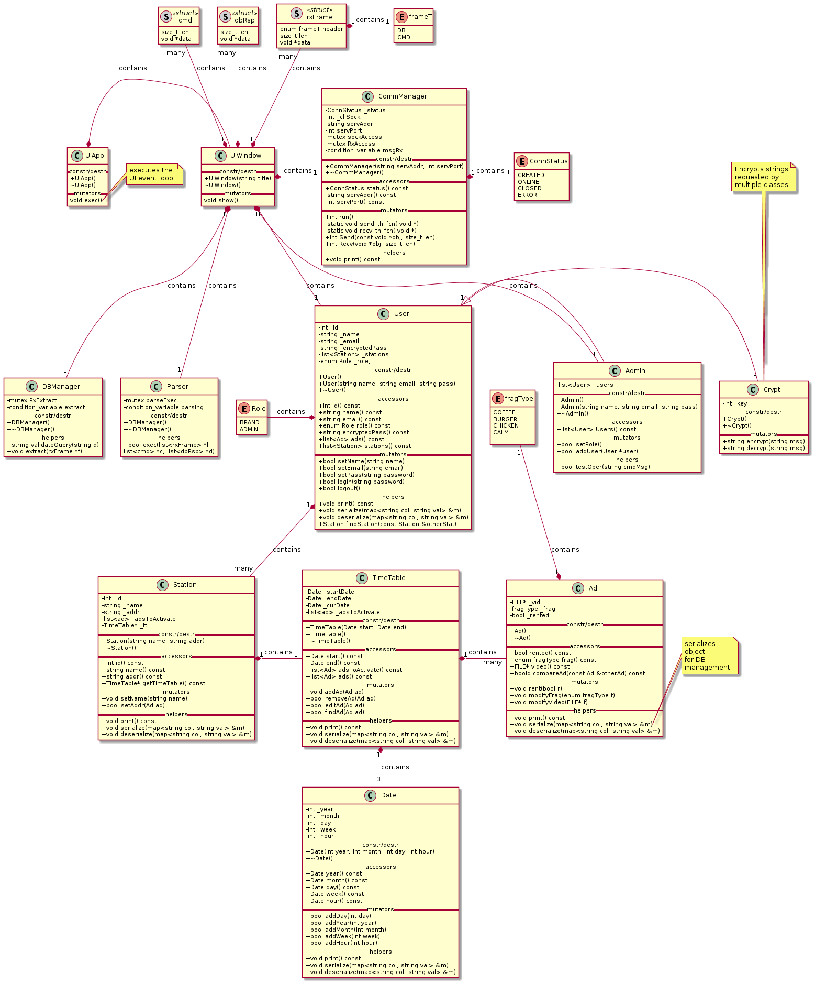
Design Class Diagram
Remote Client

Slide 60
Design Class Diagram
Remote Client

Slide 61
Design Class Diagram
Remote Client

Slide 62
Design Class Diagram
Remote Client

Slide 63
Design Class Diagram
Remote Client

Slide 64
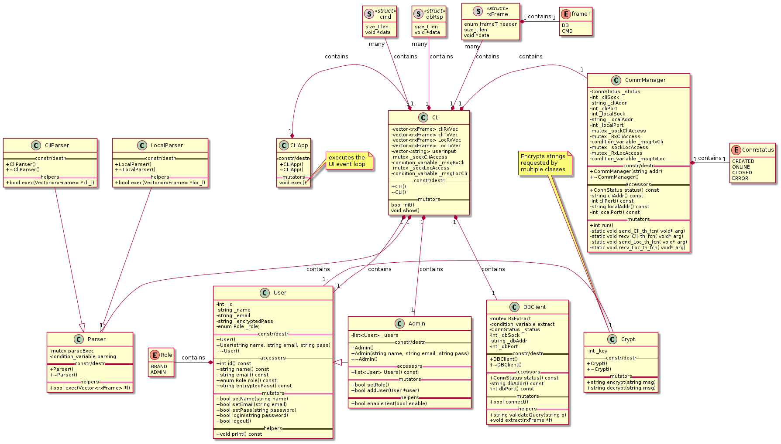
Design Class Diagram
Remote Server

Slide 65
Design Class Diagram
Remote Server

Slide 66
Design Class Diagram
Remote Server

Slide 67
Design Class Diagram
Remote Server

Slide 68
Design Class Diagram
Remote Server

Slide 69
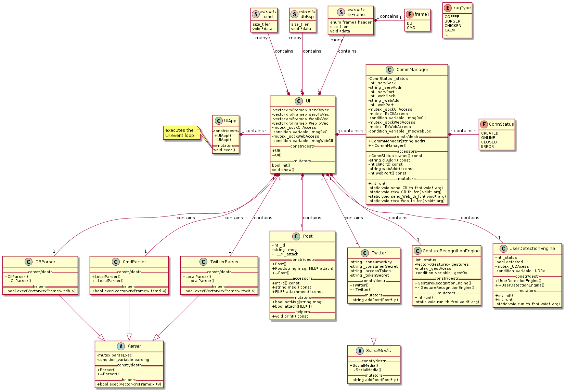
Design Class Diagram
Local System (1)

Slide 70
Design Class Diagram
Local System (1)

Slide 71
Design Class Diagram
Local System (1)

Slide 72
Design Class Diagram
Local System (1)

Slide 73
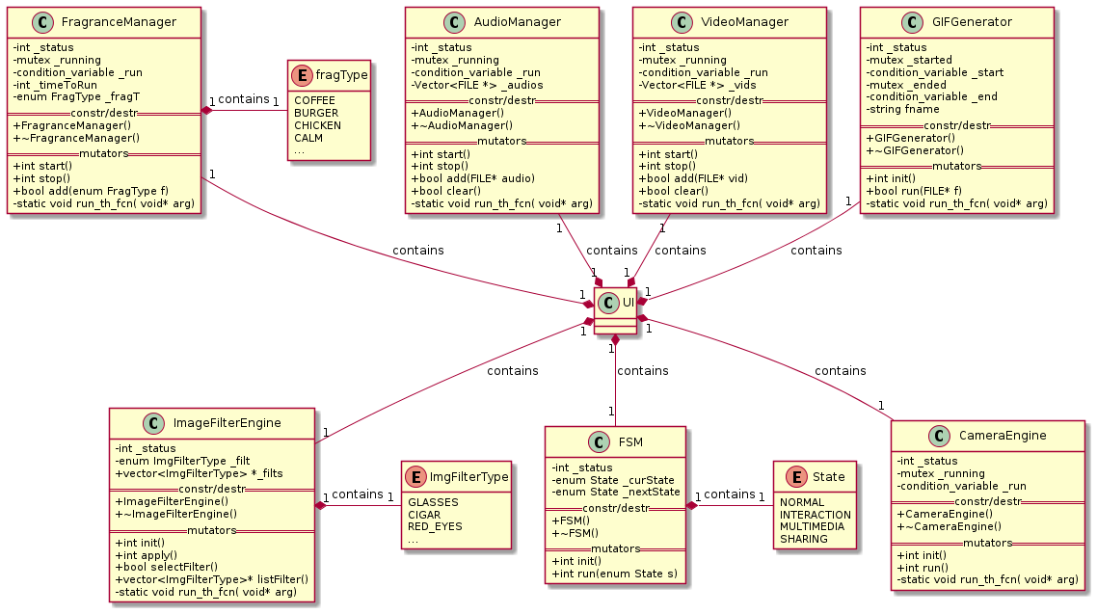
Design Class Diagram
Local System (2)

Slide 74
Design Class Diagram
Local System (2)

Slide 75
Design Class Diagram
Local System (2)

Slide 76
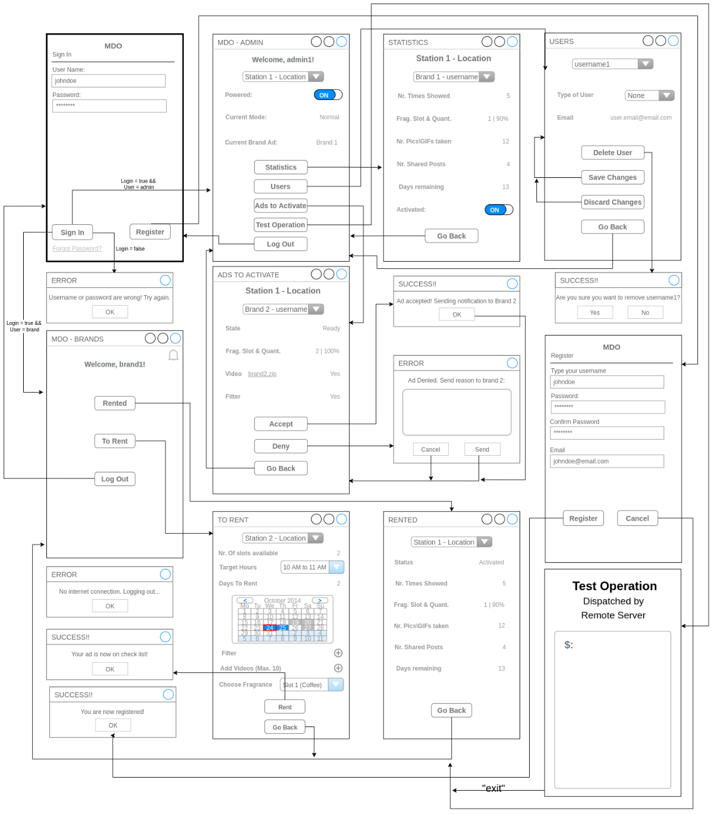
Design GUI Layouts
Remote Client

Slide 77

Design GUI Layouts
Remote Client

Slide 78
Design GUI Layouts
Remote Client

Slide 79
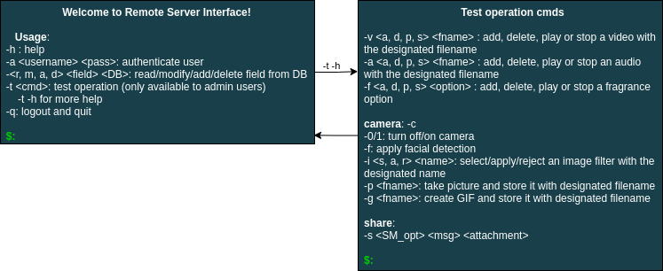
Design GUI Layouts
Remote Server

Slide 80
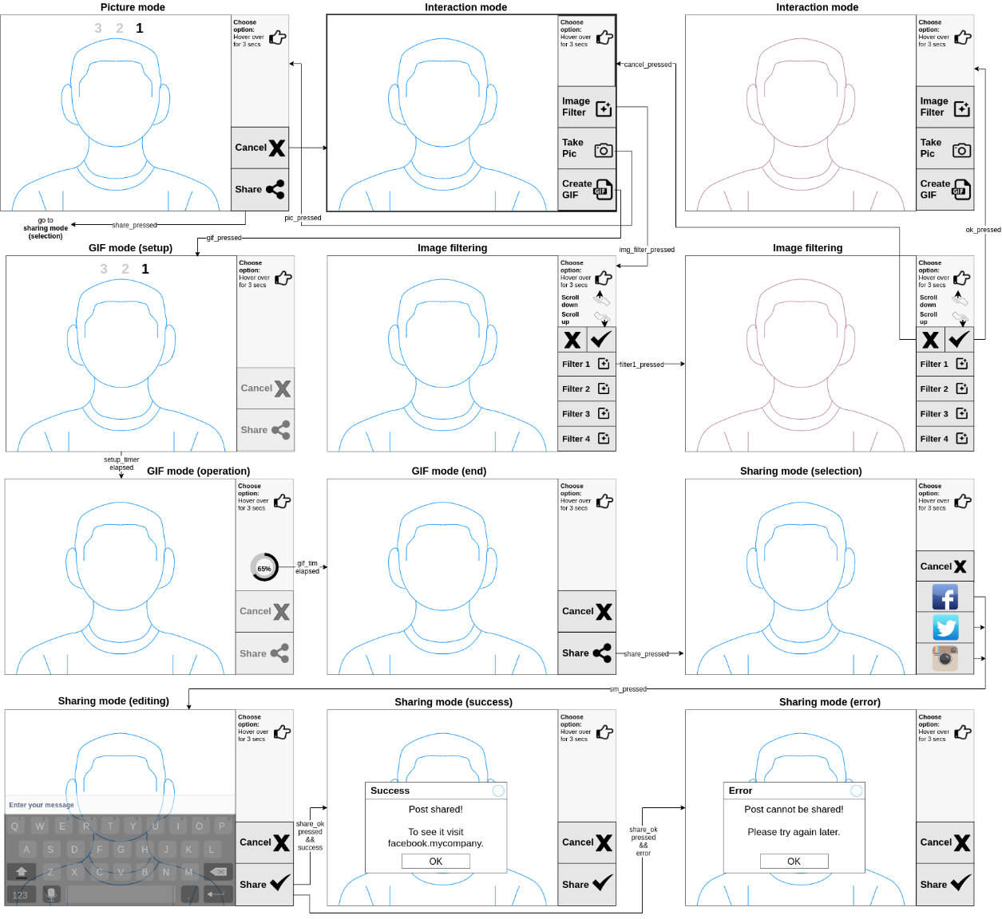
Design GUI Layouts
Local System

Slide 81
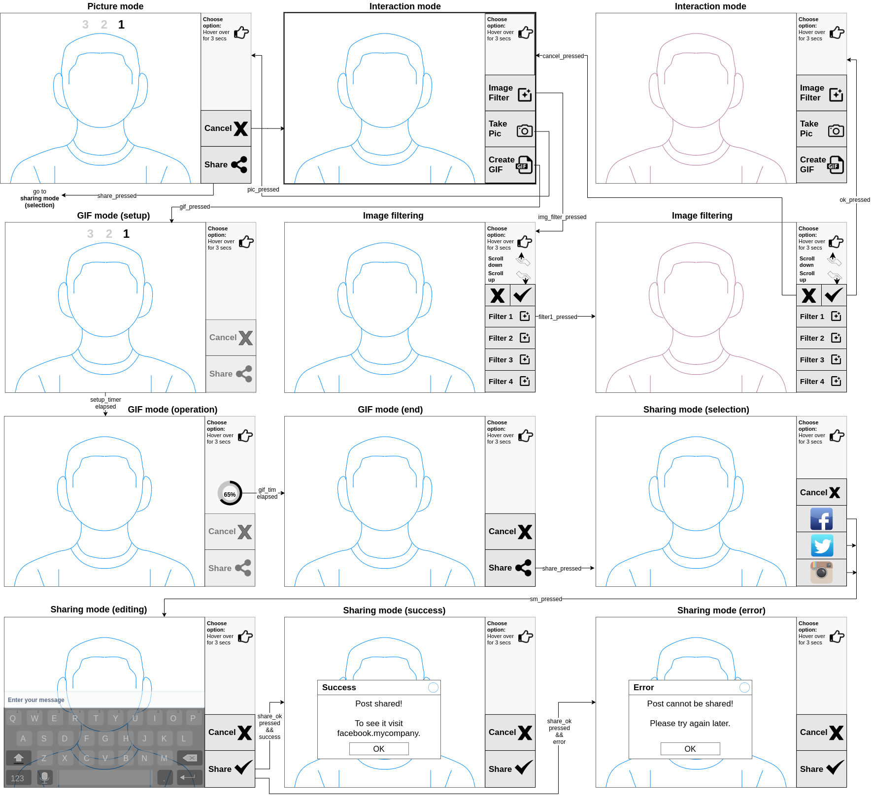
Design GUI Layouts
Local System

Slide 82
Design GUI Layouts
Local System

Slide 83
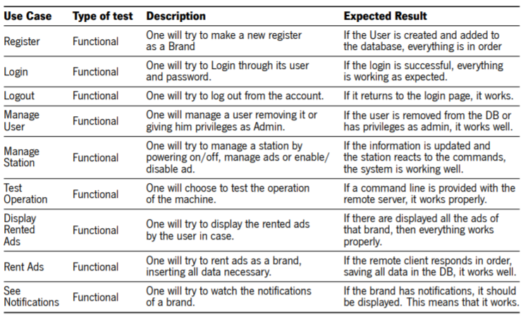
Design Software Test Cases
Remote Client

Slide 84
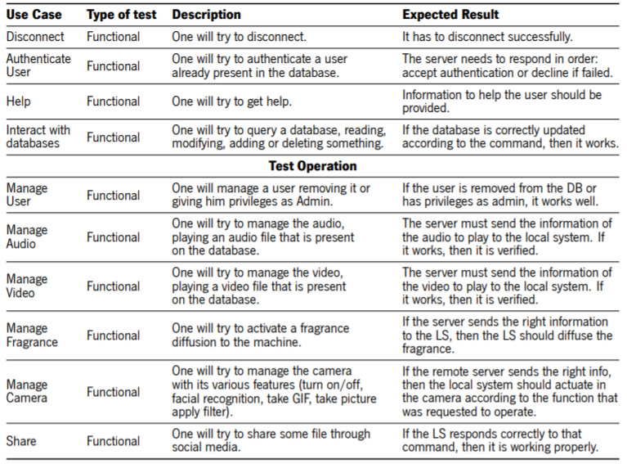
Design Software Test Cases
Remote Server

Slide 85
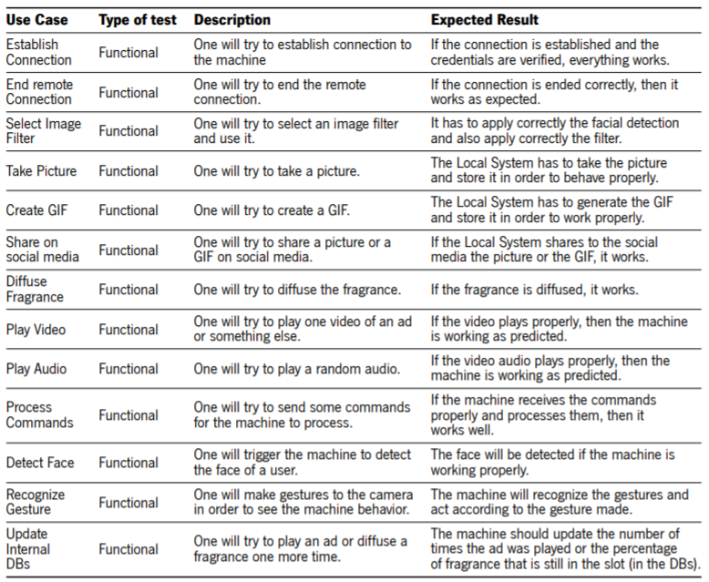
Design Software Test Cases
Local System

Slide 86
Thank you!!
Any questions?

